Slide 1
Lesson 14
New & Expiring Legislation

Slide 2
Ethics – P 572
Circular 230 Proposed Regulations
  Let’s talk about some of the PROPOSED changes

Slide 3
Circular 230 Proposed Regs – P 572
Contingent Fees
  For services in preparing
    Original tax return
    Amended tax return
    Claim for refund or credit
  Constitute disreputable conduct subject to sanction

Slide 4
Circular 230 Proposed Regs – P 573
Limited Practice & AFSP Participants
  Individuals w/AFSP Record of Completion
    May engage in limited practice before IRS
      Tax returns, claims for refund or credit
    Prepared & signed during calendar year
      For which Record of Completion was issued

Slide 5
Circular 230 Proposed Regs – P 573
Knowledge of Error or Omission
  Current law
    Requires YOU to advise a client of any
      Noncompliance with internal revenue laws
      Errors or omissions on a tax return or other document submitted to IRS
      Consequences of noncompliance

Slide 6
Circular 230 Proposed Regs – P 573
Knowledge of Error or Omission
  Proposed law
    Clarifies that the noncompliance, error, or omission may have been made by the:
      Client
      Practitioner
      Prior Practitioner

Slide 7
Circular 230 Proposed Regs – P 573
Knowledge of Error or Omission
  Proposed law
    If YOU are representing a client before a matter before the IRS
      Request the client’s agreement to disclose noncompliance, error, or omission
      If they do not agree, consider whether you can continue to represent the client

Slide 8
Circular 230 Proposed Regs – P 574
Negotiation of Payments to Clients
  You may not endorse or negotiate payments to clients!
  Proposed regulations broaden prohibition to include:
    ALL electronic payments
      Prepaid debit cards, phone or mobile payments

Slide 9
Circular 230 Proposed Regs – P 574
Best Practices for Tax Practitioners
  Create a data security policy
  Identify, evaluate, and address a mental impairment
    Age, substance abuse, physical or mental health
  Create business continuity & succession plan
    Cessation of business
    Natural disaster or cyberattack

Slide 10
Circular 230 Proposed Regs – P 574
Duty to Maintain Technological Competence
  YOU must be competent when engaging in practice before the IRS
  Proposed regs would define competency
    Understanding the benefits & risks associated with relevant technology
      To provide services to clients
      To store or transmit confidential information

Slide 11
Circular 230 Proposed Regs – P 574
Incompetence or Disreputable Conduct
  Can be sanctioned for conduct that relates to YOUR overall fitness to practice
    Is not limited to actions taken while representing clients in a matter before the IRS

Slide 12
Circular 230 Proposed Regs – P 575
Incompetence or Disreputable Conduct
  Willful failure to follow any federal tax law is disreputable conduct
  Why?
    Because knowingly violating a federal tax law reflects a lack of due regard for the tax laws

Slide 13
Circular 230 Proposed Regs – P 575
Incompetence or Disreputable Conduct
  Any penalty assessment against YOU is a violation
    Willful attempt to understate tax liabilities
    Aiding or abetting in understatement
    Careless, reckless, or intentional disregard of rules or regulations
    Promotion of abusive tax shelters

Slide 14
Overview – Learning Objectives
Discuss the One Big Beautiful Bill (OBBB) Act
  Determine which provisions of the Tax Cuts & Jobs Act of 2017 (TCJA) have been extended, made permanent, or terminated by the OBBB
  Understand the impact of the clean energy tax credits by the OBBB
  Identify the many new tax provisions impacting individuals
  Recognize additional tax rules introduced by OBBB

Slide 15

One Big Beautiful Bill Act
Additional Tax Relief
  $ 40 Billion
    Tax cut for hourly overtime workers
  $ 124 Billion
    Tax cut for tipped workers
  $ 72 Billion
    Tax relief for seniors
  $ 284 Billion
    Economic growth from manufacturers
  $ 100 Billion
    New investments in opportunity zones
Notes:
I am sure you are all already aware but just a reminder that the due date is actually April 15
Remember this could change if you have a taxpayer that lives in a disaster area – for example, there are some taxpayers in disaster areas during 2023 that haven’t filed their 2022 returns yet because their extended deadline is 2/15/24 – see for example IL-2023-07 issued on 11/24/23 for Illinois taxpayers that reside or have a business in Cook County – relates to returns that were due after 9/17/23 – so includes payroll taxes due Oct 31 and Jan 31, 24, quarterly estimates that would be due on 1/16, calendar year corporate returns that were on extension until 10/16
Of course keep in mind that Illinois did not follow these rules
I wonder about smaller refunds not because the child tax credits are currently set to be different from 2022 returns – I worry more about the stock market come back and higher investment income
I say may on the student loan interest only because it’s hard to say how much has actually been paid
Remember the program getting press this week has been in place for 10 years – the borrowers have worked in public service for 10 years and have been making payments on the loans for 20 years. Debts will be cancelled under the SAVE plan

Slide 16
One Big Beautiful Bill Act
Additional Tax Relief – Cont’d
  $ 13,000
    Increase in take home pay for a family with 2 children
  6 Million
    American jobs saved
  40 Million
    Families receive increased Child Tax Credit
  2 Million
    Family farms saved from higher death tax
Notes:
I am sure you are all already aware but just a reminder that the due date is actually April 15
Remember this could change if you have a taxpayer that lives in a disaster area – for example, there are some taxpayers in disaster areas during 2023 that haven’t filed their 2022 returns yet because their extended deadline is 2/15/24 – see for example IL-2023-07 issued on 11/24/23 for Illinois taxpayers that reside or have a business in Cook County – relates to returns that were due after 9/17/23 – so includes payroll taxes due Oct 31 and Jan 31, 24, quarterly estimates that would be due on 1/16, calendar year corporate returns that were on extension until 10/16
Of course keep in mind that Illinois did not follow these rules
I wonder about smaller refunds not because the child tax credits are currently set to be different from 2022 returns – I worry more about the stock market come back and higher investment income
I say may on the student loan interest only because it’s hard to say how much has actually been paid
Remember the program getting press this week has been in place for 10 years – the borrowers have worked in public service for 10 years and have been making payments on the loans for 20 years. Debts will be cancelled under the SAVE plan

Slide 17
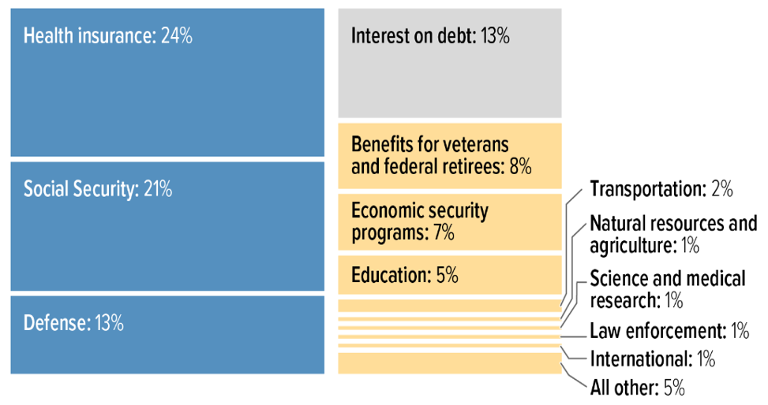
The Budget

Slide 18

Fringe Benefits – P 575
Qualified Bicycle Commuting Reimbursement – Section 70112
  IRC 132(f)
  Permanently eliminates the exclusion for qualified bicycle commuting reimbursement
  Tax years beginning after December 31, 2025

Slide 19

Fringe Benefits – P 575
Dependent Care Assistance Program – Section 70404
  IRC 129
  Contribution limits increased from $ 5,000 to $ 7,500 ($ 3,750 MFS)
  Excluded from income
  Tax years beginning after December 31, 2025

Slide 20

Individual Income Tax Issues – P 575
Alternative Minimum Tax – Section 70107
  IRC 55
  Permanently extends the increased AMT exemptions
  Resets phaseout thresholds to the 2018 levels
  Tax years beginning after December 31, 2025

Slide 21
Individual Income Tax Issues – P 575
Alternative Minimum Tax – Section 70107
  Phaseout thresholds
    $ 500,000 Single
    $ 1,000,000 MFJ
      Adjusted for inflation
      Reduced by 50 cents (currently 25 cents) for every $ 1 over threshold; therefore, it will phaseout more quickly

Slide 22
TCJA Provisions Made Permanent
Alternative Minimum Tax through the years!
2017
$ 84,500 – Phaseout AGI over $ 160.900 – MFJ
TCJA for 2025, for example
$ 137,000 – Phaseout AGI over $ 1,252,700 – MFJ
Beginning 2026 OBBB
Makes TCJA permanent increased exemptions adjusted for inflation and reset phaseout thresholds to 2018 levels
$ 54,300 – Phaseout AGI over $ 120.700 – Single & HoH
$ 42,250 – Phaseout AGI over $ 80,450 - MFS
$ 88,100 – Phaseout AGI over $ 626,350 – Single & HoH
$ 68,500 – Phaseout AGI over $ 626,350 - MFS

Slide 23

Individual Income Tax Issues – P 576
No Tax on Car Loan Interest – Section 70203
  IRC 163(h)
  Tax years 2025-2028
  Above-the-line deduction up to $ 10,000 for qualified passenger vehicle loan interest
  Vehicle’s final assembly must occur in US

Slide 24

Individual Income Tax Issues – P 576
No Tax on Car Loan Interest – Cont’d
  Income limits!
    MAGI phaseout $ 100,000 to $ 150,000
    MAGI phaseout $ 200,000 to $ 250,000 (MFJ)
  Must include Vehicle ID # (VIN) on return

Slide 25

Individual Income Tax Issues – P 576
No Tax on Car Loan Interest – Cont’d
  The term qualified passenger vehicle loan interest means:
    Any interest (paid or accrued) on indebtedness after December 31, 2024
    Secured by a first lien on an applicable passenger vehicle for personal use

Slide 26

Individual Income Tax Issues – P 576
No Tax on Car Loan Interest – Cont’d
  An applicable passenger vehicle means:
    Original use commences with taxpayer
    Manufactured primarily for use on public streets, roads, and highways
    Has at least 2 wheels
    Car, minivan, van, SUV, pickup truck, or motorcycle
    Gross vehicle weight < 14,000 pounds
    Final assembly occurred within the US

Slide 27

Individual Income Tax Issues – P 576
No Tax on Car Loan Interest – Cont’d
  Does not include amounts paid for:
    A loan to finance fleet sales
    A loan to purchase a commercial vehicle not used for personal purposes
    Any lease financing
    A loan to finance the purchase of a vehicle with a salvage title
    A loan to finance the purchase of a vehicle for scrap/parts

Slide 28

Individual Income Tax Issues – P 577
Child and Dependent Care Credit – Section 70405
  IRC 21(a)
  Permanently increases the qualifying expenses to compute the credit to 50% beginning after December 31, 2025
  Credit is phased down as income increases

Slide 29

Individual Income Tax Issues – P 577
Enhanced Adoption Credit – Section 70402
  IRC 23
  Up to $ 5,000 of the adoption credit is refundable after December 31, 2024
    Indexed for inflation annually
  Refundable portion cannot be carried forward
    Nonrefundable can be

Slide 30

Individual Income Tax Issues – P 577
Increased Child Tax Credit (CTC) – Section 70104
  IRC 24
  Makes CTC increase permanent while enhancing the CTC from $ 2,000 to $ 2,200 beginning in 2025
    Indexed for inflation beginning 2026
  Leaves the $ 1,400 refundable credit unchanged
    Currently, $ 1,700 indexed for inflation

Slide 31

Individual Income Tax Issues – P 577
Increased Child Tax Credit – Cont’d
  Maintains the increased income phaseout thresholds
    $ 200,000 Single & $ 400,000 MFJ
      Reduced by $ 50 for each $ 1,000 over threshold
  Maintains the $ 500 nonrefundable credit for other dependents

Slide 32

Individual Income Tax Issues – P 577
Increased Child Tax Credit – Cont’d
  SSN required for child
  SSN required for at least one spouse
    MFJ return
  SSN must be issued by SSA
    BEFORE the due date of the return
  Child and parent must be US citizens

Slide 33

Individual Income Tax Issues – P 577
Social Security Requirement for Education Credits – Section 70606
  IRC 25A
  Taxpayer claiming the credit (for self or another person) must provide SSN!
    American Opportunity Credit
    Lifetime Learning Credit (LLC)
  Must also provide institution’s EIN for LLC!
  Amendment applies in 2026!

Slide 34

Individual Income Tax Issues – P 578
Termination of Energy Efficient Home Improvement Credit – Section 70505
  The IRC 25C credit is terminated for any expenditures made after 2025 (vs. 2032)
    Energy efficient windows, doors, HVAC property, and home energy audits

Slide 35

Individual Income Tax Issues – P 579
Termination of Residential Clean Energy Credit – Section 70506
  The IRC 25D credit is terminated for any expenditures made after 2025 (vs. 2034)
    Installation of solar, small wind, and geothermal heat pumps

Slide 36

Individual Income Tax Issues – P 579
Termination of Previously Owned Clean Vehicle Credit – Section 70501
  The IRC 25E credit is terminated for vehicles acquired after September 30, 2025 (vs. December 31, 2032)

Slide 37

Individual Income Tax Issues – P 579
Tax Credit for Contributions of Individuals to Scholarship Granting Organizations – Section 70411
  IRC 25F – New!
  Allows a credit to US citizen or resident
    For qualified contributions to a scholarship granting organization
    Cannot exceed $ 1,700
  Beginning tax years after 2026

Slide 38

Individual Income Tax Issues – P 579
Tax Credit for Contributions of Individuals to Scholarship Granting Organizations – Cont’d
  Scholarship Granting Organization is:
    IRC 501(c)(3) organization AND
    IRC 501(a) exempt from tax
    Does not include a private foundation

Slide 39

Individual Income Tax Issues – P 579
Scholarship Granting Organization must meet requirements:
  Provide scholarships to 10 or more students who do not all attend the same school
  Spend 90% or more of its income on scholarships
  Provide scholarships for qualified elementary or secondary qualified education expenses
  Provide a scholarship to eligible students
    1st Priority: Students awarded $ the prior school year
    2nd Priority: Any eligible students who have a sibling who was awarded a scholarship from the organization

Slide 40

Individual Income Tax Issues – P 579
Scholarship Granting Organization must meet requirements:
  Does not earmark or set aside contributions for scholarships on behalf of any student
  Verifies the annual household income and family size of eligible students who apply
  Limits the awarding of scholarships to eligible students who are a member of a household for which the income does not exceed the threshold limit

Slide 41

Individual Income Tax Issues – P 579
Eligible Student means:
  Individual who is a member of a household
  Income is not > 300% of the area median gross income
    For calendar year prior to applying for the scholarship
  Eligible to enroll in public elementary or secondary school

Slide 42

Individual Income Tax Issues – P 580
Qualified Contributions means:
  Cash contribution to a scholarship granting organization
    To fund scholarships for eligible students
    Within the state in which the organization is listed

Slide 43

Individual Income Tax Issues – P 580
Tax Credit for Contributions of Individuals to Scholarship Granting Organizations – Cont’d
  IRC 139K – New!
  Grants an exclusion from gross income for amounts received after 2026

Slide 44

Individual Income Tax Issues – P 580
Termination of Clean Vehicle Credit – Section 70502
  The IRC 30D credit is terminated for vehicles acquired after September 30, 2025 (vs. December 31, 2032)

Slide 45

Individual Income Tax Issues – P 580
Eliminating Limitation on Recapture of Advance Payment of Premium Tax Credit – Section 71305
  IRC 36B
  Repayment cap is eliminated after 2025
    Must repay any excess regardless of household income
  See Rev. Proc. 2025-25, 2025-32 IRB 311

Slide 46

Individual Income Tax Issues – P 581
Termination of New Energy Efficient Home Credit – Section 70508
  The IRC 45L credit for constructing a new energy efficient home expires on June 30, 2026 (vs. December 31, 2032)

Slide 47

Individual Income Tax Issues – P 581
Increased Standard Deduction – Section 70102
  IRC 63(c)
  Increased (nearly doubled) standard deduction made permanent after 2025
  Increases the standard deduction beginning 2025

Slide 48
Individual Income Tax Issues – P 581
Increased Standard Deduction – Cont’d
  2025-2028
    Additional $ 1,000 Single
    Additional $ 1,500 Head of Household
    Additional $ 2,000 Married Filing Joint

Slide 49
TCJA Provisions Made Permanent
Standard Deduction through the years!
2017
$ 6,350 for Single & MFS
$ 9,340 for HoH
$ 12,700 for MFJ & Surviving Spouse
2024
$ 14,600 for Single & MFS
$ 21,900 for HoH
$ 29,200 for MFJ & Surviving Spouse

Slide 50
TCJA Provisions Made Permanent
Standard Deduction for 2025!!!
2025 – Indexed for Inflation – Pre-OBBB Act
$ 15,000 for Single & MFS
$ 22,500 for HoH
$ 30,000 for MFJ & Surviving Spouse
2025 – OBBB – Cost $ 1.3 Trillion
$ 15,750 for Single & MFS
$ 23,625 for HoH
$ 31,500 for MFJ & Surviving Spouse

Slide 51

Individual Income Tax Issues – P 581
Miscellaneous Itemized Deduction – Section 70110
  IRC 67(g)
  Permanently eliminates all miscellaneous itemized deductions subject to the 2% AGI floor, including, for example:
    Unreimbursed employee expenses
    Hobby expenses
    Investment fees

Slide 52

Individual Income Tax Issues – P 581
Miscellaneous Itemized Deduction – Cont’d
  Beginning in 2026, special exemption for unreimbursed educator expenses allowed as an itemized deduction with no dollar limit
  $ 300 above the line deduction remains available as per IRC 62

Slide 53

Individual Income Tax Issues – P 581
Miscellaneous Itemized Deduction – Cont’d
  Eligible educator defined:
    K-12 teachers, instructors, counselors, interscholastic sports administrators and coaches, principals, and certain aides
  Eligible educator expenses include:
    Certain nonathletic instructional equipment
      Books, supplies, equipment

Slide 54

Individual Income Tax Issues – P 582
Itemized Deductions Limitation – Section 70111
  IRC 68
  Permanently repeals the overall “Pease limitation” on itemized deductions beginning after December 31, 2025

Slide 55

Individual Income Tax Issues – P 582
Itemized Deductions Limitation – Cont’d
  Replaces “Pease limitation” with a new and simpler overall limitation
    2/37 of lesser of:
      Itemized deductions OR
      Amount of taxable income > 37% bracket threshold

Slide 56

Individual Income Tax Issues – P 582
Itemized Deductions Limitation – Cont’d
  Example 14.1
    Limit on Itemized Deductions – 37% Bracket
  Example 14.2
    No Limit on Itemized Deductions – 35% Bracket

Slide 57

Individual Income Tax Issues – P 582
Moving Expenses Deduction – Section 70113
  Beginning 2026, IRC 217(k) permanently repeals the deduction for moving expenses except
    Certain Armed Forces and Intelligence Community personnel

Slide 58
Individual Income Tax Issues – P 582
Moving Expenses Exclusion – Cont’d
  Beginning 2026, IRC 132 permanently eliminates the exclusion from income for reimbursed moving expenses except
    Certain Armed Forces and Intelligence Community personnel

Slide 59

Individual Income Tax Issues – P 583
Termination of Deduction for Personal Exemptions – Section 70103
  OBBB permanently repealed the personal exemption
  However, you must know the rules for other tax issues
    Filing status
    Child tax credit
    Earned income tax credit

Slide 60
TCJA Provisions Made Permanent
Personal Exemption through the years!
2017
$ 4,050 personal exemption, generally
2018-2025
Suspended by TCJA
2026 forward
Permanently repealed by OBBB

Slide 61

Individual Income Tax Issues – P 583
Temporary Senior (65 or older) Deduction - Section 70103
  IRC 151
  Tax years 2025-2028
  New additional $ 6,000 “standard deduction”
  Available to taxpayers who itemize, too!
  Married senior(s)? Must file MFJ!

Slide 62

Individual Income Tax Issues – P 583
Temporary Senior (65 or older) Deduction - Cont’d
  Income limits!
    MAGI phaseout $ 75,000 Single
    MAGI phaseout $ 150,000 MFJ
      Reduced by 6% over threshold

Slide 63

Individual Income Tax Issues – P 583
Qualified Resident Interest – Section 70108
  IRC 163(h)
  Permanently extends the TCJA provision lowering the home mortgage interest deduction
    $ 1 Million to $ 750,000 ($ 375,000 MFS)

Slide 64
Individual Income Tax Issues – P 583
Qualified Resident Interest – Section 70108
  IRC 163(h)
  EXCEPTION
    For indebtedness incurred on or before December 15, 2017, the limit remains $ 1 Million ($ 500,000 MFS)

Slide 65
Individual Income Tax Issues – P 583
Qualified Resident Interest – Cont’d
  Permanently excludes home equity indebtedness from the definition of qualified residence interest
    EXCEPTION:
      Loans used to buy, build, or substantially improve the taxpayer’s home that secures the loan

Slide 66

Individual Income Tax Issues – P 583
State & Local Tax (SALT) Deduction Limitation – Section 70120
  IRC 164(b)(6)
  Increases the TCJA $ 10,000 ($ 5,000 MFS) cap to $ 40,000 ($ 20,000 MFS) beginning 2025
  Increase the cap annually by 101% of the prior year’s limit through 2029
  Beginning in 2030, the limit is $ 10,000

Slide 67

Individual Income Tax Issues – P 583
State & Local Tax (SALT) Deduction Limitation – Cont’d
  Tax years 2025-2029
  Cap reduced by 30% when MAGI exceeds
    $ 500,000 ($ 250,000 MFS) in 2025
    $ 505,000 ($ 252,500 MFS) in 2026
    101% of prior year’s income threshold through 2029
  Limit cannot fall below $ 10,000

Slide 68

Individual Income Tax Issues – P 584
Wagering Losses – Section 70114
  IRC 165
  Beginning in 2026, wagering losses limited to both:
    90% of the loss
    Extent of gains from the transactions
  Let’s do some examples!

Slide 69

Individual Income Tax Issues – P 584
Wagering Losses – Section 70114
  Susan wins $ 20,000 and loses $ 20,000 at the casino
    $ 20,000 x 90% = $ 18,000 loss limitation
      $ 20,000 gambling income reported
      $ 18,000 gambling loss reported as itemized deduction (not subject to 2%)

Slide 70

Individual Income Tax Issues – P 584
Wagering Losses – Section 70114
  Susan wins $ 50,000 and loses $ 20,000 at the casino
    $ 20,000 x 90% = $ 18,000 loss limitation
      $ 50,000 gambling income reported
      $ 18,000 gambling loss reported as itemized deduction (not subject to 2%)

Slide 71

Individual Income Tax Issues – P 584
Wagering Losses – Section 70114
  Susan wins $ 20,000 and loses $ 22,000 at the casino
    $ 22,000 x 90% = $ 19,800 loss limitation
      $ 20,000 gambling income reported
      $ 19,800 gambling loss reported as itemized deduction (not subject to 2%)

Slide 72

Individual Income Tax Issues – P 584
Charitable Contributions for Itemizers – Section 70425
  IRC 170(b)
  Beginning in 2026, OBBB imposes a new floor on the charitable deduction
    Individuals
      Reduced by 0.5% of contribution base (typically AGI)
      60% contribution limit made permanent

Slide 73
Individual Income Tax Issues – P 584
Charitable Contributions for Itemizers – Section 70425
  IRC 170(b)
  Beginning in 2026, OBBB imposes a new floor on the charitable deduction
    Corporations
      Reduced by 1% of contribution base
      Further limited by 10% of taxable income

Slide 74

Individual Income Tax Issues – P 584
Charitable Contributions by Non-Itemizers – Section 70424
  IRC 170(p)
  Beginning in 2026, OBBB creates a permanent CASH charitable contribution for those who do not itemize limited to:
    $ 1,000 – Single
    $ 2,000 – MFJ
  CAUTION: It’s not a “gimme!”

Slide 75

Individual Income Tax Issues – P 587
Casualty Loss Disaster – Section 70438
  Casualty Loss Calculation
    Lesser of:
      Adjusted Basis or decrease in FMV
    Less Insurance
    Loss Limitations:
      $ 100 per event
      10% of AGI

Slide 76
Individual Income Tax Issues – P 587
Casualty Loss Disaster – Section 70438
  Casualty Loss Calculation
  Reminder
    For qualified disaster losses, the 10% of AGI limitation does not apply and the $ 100 reduction is increased to $ 500

Slide 77

TCJA Provisions Made Permanent
Casualty Loss Disaster – Cont’d
  Qualified Disaster Loss
    Major disaster declared by POTUS under Section 401 of the Stafford Act and that occurred in 2018 and before December 21, 2019, and continued no later than January 19, 2020.
    Major disaster declared by POTUS during the period between January 1, 2020, and February 10, 2025. Also, this disaster must have an incident period that began on or after December 29, 2019, and on or before December 12, 2024, and must have ended no later than January 11, 2025.

Slide 78

Individual Income Tax Issues – P 587
Casualty Loss Deduction - Section 70109
  IRC 165(h)
  Makes permanent the TCJA provision limiting the deduction of casualty or theft losses of personal-use property to those attributable to federally declared disasters
  New in 2026, the Act extends the casualty loss deduction to losses attributable to a state declared disasters

Slide 79

Individual Income Tax Issues – P 587
Casualty Loss Deduction – Cont’d
  REMINDER: Exception to TCJA (2018-2025)
    Personal casualty losses not related to a federally declared disaster area may be used to offset casualty gains

Slide 80

Individual Income Tax Issues – P 589
Student Loan Discharge – Section 70119
  IRC 108(f)(5)
  Permanently excludes from gross income student loans discharged because of death or permanent disability of the student
  Requires SSN to be shown on the return
  Amendment applies beginning 2026

Slide 81
Individual Income Tax Issues – P 589
Employer Payments of Student Loans Exclusion – Section 70412
  IRC 127(c)(1)(B)
  Permanently excludes from gross income student loans paid by the employer
  $ 5,250 exclusion is adjusted for inflation
    Beginning after 2026
  Requires SSN to be shown on the return
    Amendment applies beginning 2026

Slide 82

Individual Income Tax Issues – P 590
Individual Tax Rates – Section 70101
  IRC 1(j)
  Makes permanent the modified federal income tax bracket schedule and lower tax rates by the TCJA
  Adds an additional year of inflation adjustment to the end of the 10% and 12% tax brackets
  Increases the income at which the 22% bracket begins

Slide 83
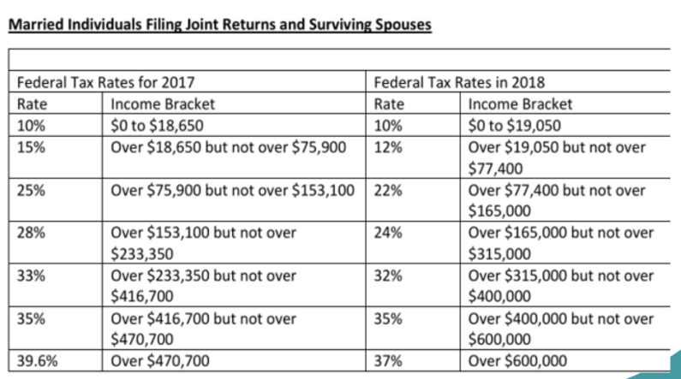
TCJA Provisions Made Permanent
Individual Tax Rates – Section 70101
  Cost $ 2.2 trillion over the next 10 years!

Slide 84
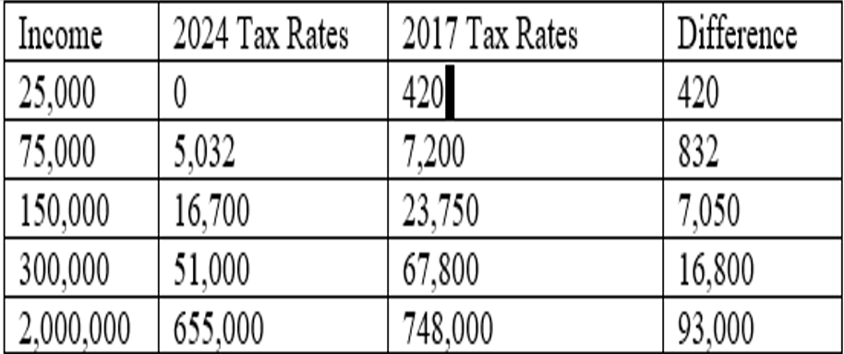
TCJA Provisions Made Permanent
Individual Tax Rates – Section 70101
This assumes no dependents and claiming the SINGLE standard deduction!

Slide 85

Q & A

